Slide 1

Behavior Analysis Technologies
Session 19
Introduction to Recommender Systems
Applied Data Science
2024/2025

Slide 2
From Search to Recommendation
“The Web is leaving the era of search and
entering one of discovery. What's the difference?
Search is what you do when you're looking for
something. Discovery is when something
wonderful that you didn't know existed, or didn't
know how to ask for, finds you.” – CNN Money, “The race
to create a 'smart' Google
Introduction to Recommender Systems
Session 19

Slide 3
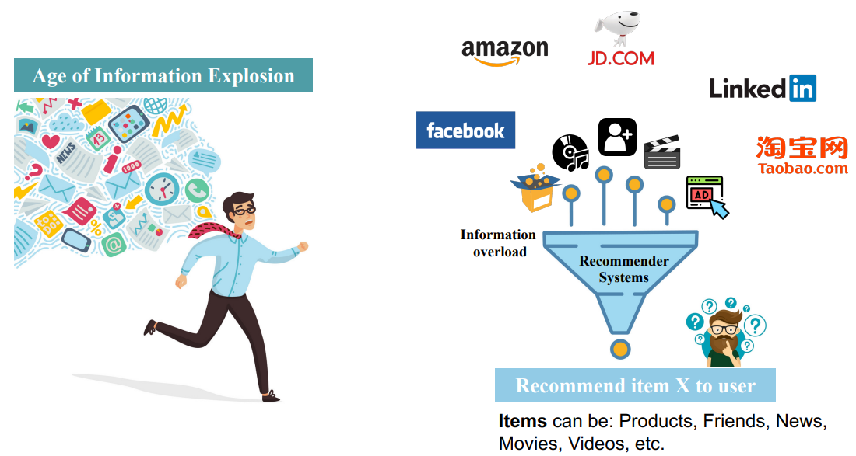


Recommender Systems
Introduction to Recommender Systems
Session 19

Slide 4
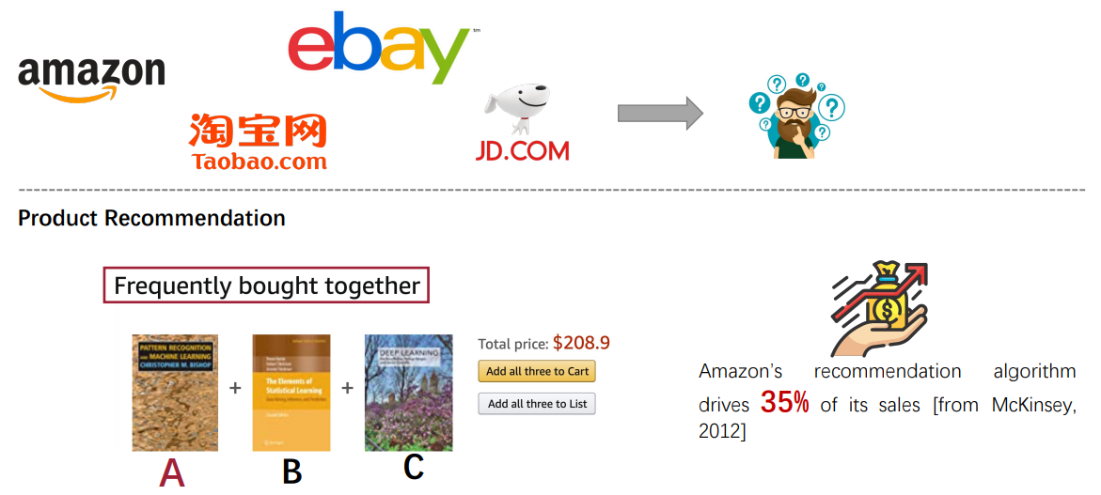


Recommender Systems
Recommendation has been widely applied in online services:
E-commerce, Content Sharing, Social Networking ...
Introduction to Recommender Systems
Session 19

Slide 5
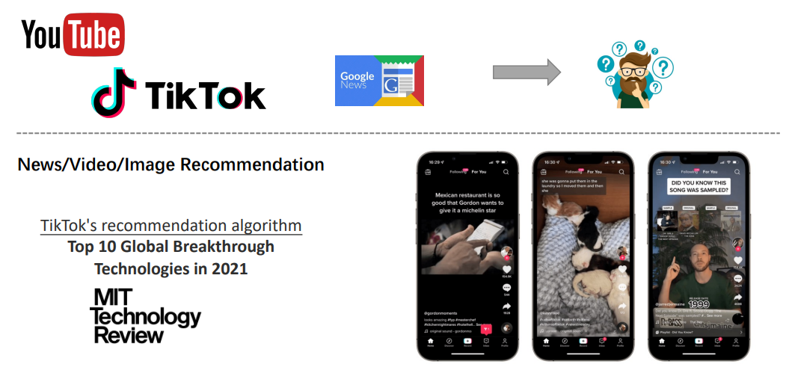
Recommender Systems
Recommendation has been widely applied in online services:
E-commerce, Content Sharing, Social Networking ...
Introduction to Recommender Systems
Session 19

Slide 6
The "Recommender Problem"
Estimate a utility function
to predict how
a user will like an item.
Introduction to Recommender Systems
Session 19

Slide 7
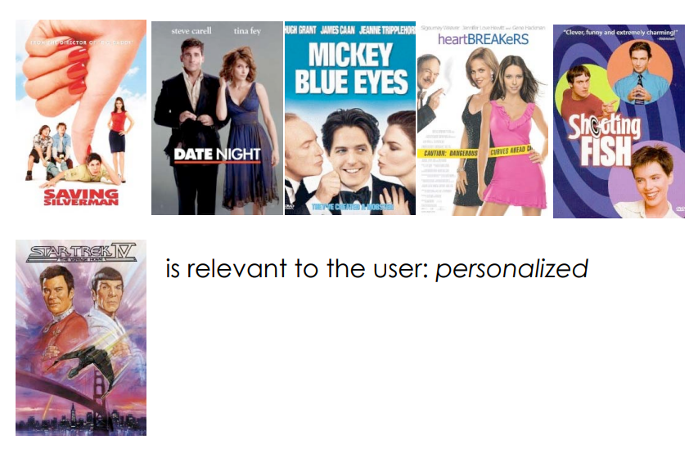
A Good Recommendation...
Is relevant to the iser: personalized
Introduction to Recommender Systems
Session 19

Slide 8

A Good Recommendation...
Is diverse:
It representes multiple possible interests of one user
Introduction to Recommender Systems
Session 19

Slide 9
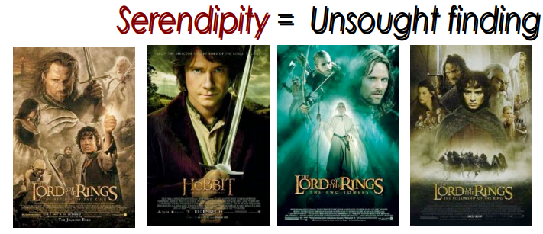
A Good Recommendation
Does not recommend items the user already knows.
Expandas the user's taste into neighboring areas.
Introduction to Recommender Systems
Session 19

Slide 10
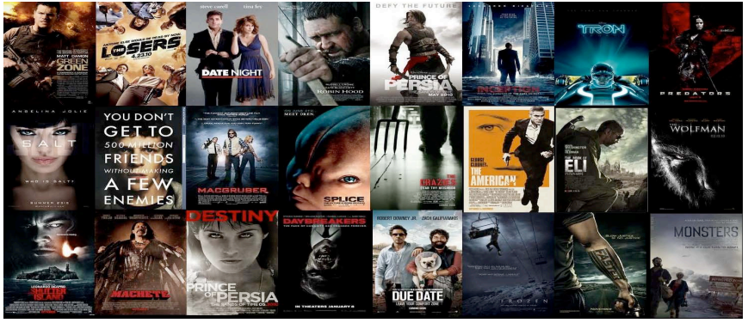
Top K Recommendations
Users take into account only few suggestions.
There is a need to do better on the top scoring recommended items.
Introduction to Recommender Systems
Session 19

Slide 11
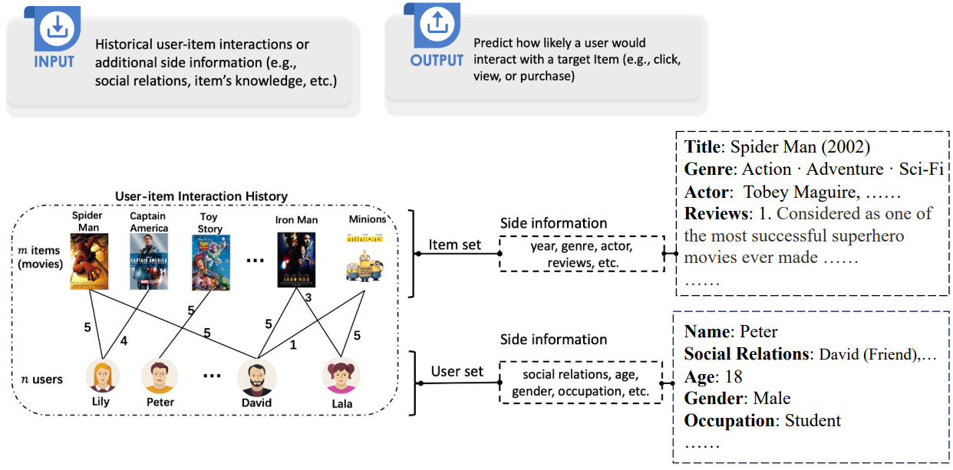
Recommender Systems
Introduction to Recommender Systems
Session 19

Slide 12
Recommender Systems Setup
You have n users and m items in your system
Typically, n >> m. E.g., Youtube: 2.6B users, 800M videos
Based on the content, we have a way of measuring user preference
This data is put together into a user-item interaction matrix.
Task: Given a user u_{i} or item v_{j}, predict one or more items to recommend.
Introduction to Recommender Systems
Session 19

Slide 13
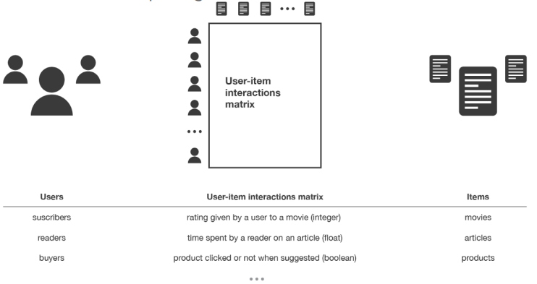
Recommender Systems Setup
This data is put together into a user-item interaction matrix.
Task: Given a user u_{i} or item v_{j}, predict one or more items to recommend.
Introduction to Recommender Systems
Session 19

Slide 14
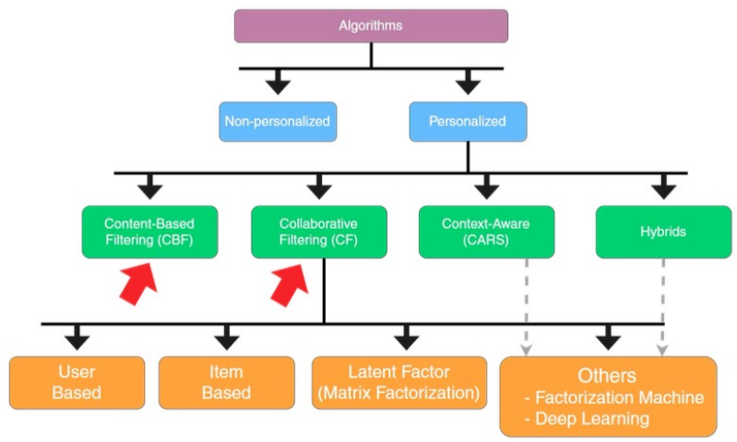
Recommender Systems Taxonomy
Introduction to Recommender Systems
Session 19

Slide 15
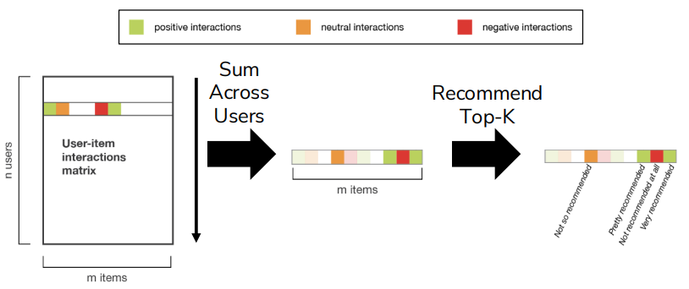
Non-Personalized Recommender Systems
Simplest approach: Just recommend whatever is popular
Rank by global popularity (i.e. Avengers Endgame)
Introduction to Recommender Systems
Session 19

Slide 16

Non-Personalized Recommender Systems
Pros:
Easy to Implement
Cons:
No personalization
Feedback Loops
Top-K recommendations might be redundant
e.g., when a new Harry Potter is released, the others may also jump into top-k popularity
Introduction to Recommender Systems
Session 19

Slide 17
Content-Based Recommendations
Basic approach to recommendation
Compare items based on attributes
Items have profiles:
Movies --> [genre, director, actors, plot, release year]
News --> [set of keywords]
User that liked an item is likely to like similar items.
Example:
Movie recommendations:
Recommend movies with same actor(s), director, genre, etc.
Websites, blogs, news:
Recommend other sites with "similar" content
Introduction to Recommender Systems
Session 19

Slide 18
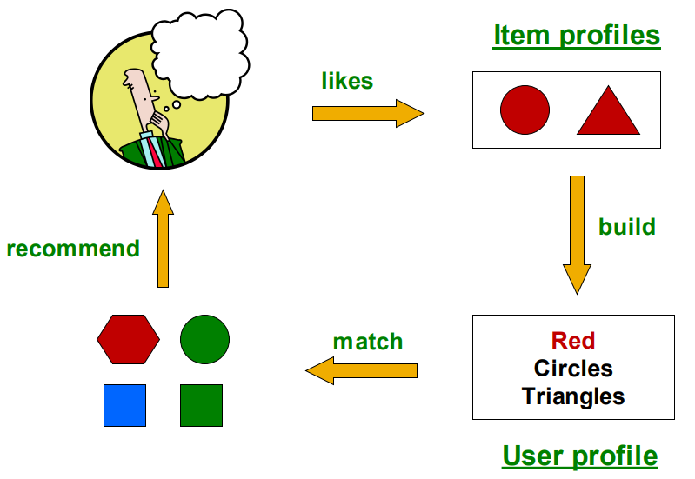
Content-Based Recommendations
Introduction to Recommender Systems
Session 19

Slide 19
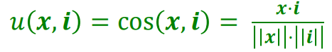
Content-Based Recommendations
User profile possibilities:
Weighted average of rated item profiles
Variation: weight by difference from average rating for item
Prediction heuristic: Cosine similarity of user and item profiles
Given user profile x and item profile i, estimate
Introduction to Recommender Systems
Session 19

Slide 20
Content-Based Recommendations
Pros:
No need for data on other users
No item cold-start problem, no sparsity problem
Able to recommend to users with unique tastes
Able to recommend new and unpopular items
No first-rater problem
Able to provide explanations
Can provide explanations of recommended items by listing content-features that caused na item to be recommended
Introduction to Recommender Systems
Session 19

Slide 21
Content-Based Recommendations
Cons:
Finding the appropriate features is hard
E.g., images, movies, music
Recommendations for new users
How to build a user profile?
Overspecialization
Never recommends items outside user's content profile
People might have multiple interests
Unable to exploit quality judgments of other users
Introduction to Recommender Systems
Session 19

Slide 22
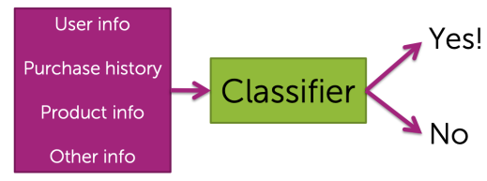
Content-Based Recommendations: Classification Model
Train a classifier to learn whether or not someone will like an item.
Pros:
Personalized
Features can capture context (time of day, recent history, …)
Can even handle limited user history (age of user, location, …)
Introduction to Recommender Systems
Session 19

Slide 23
Content-Based Recommendations: Classification Model
Train a classifier to learn whether or not someone will like an item.
Cons:
Features might not be available or hard to work with
Often doesn’t perform well in practice when compared to more advanced techniques like collaborative filtering
Can still lead to feedback loops
Introduction to Recommender Systems
Session 19

Slide 24
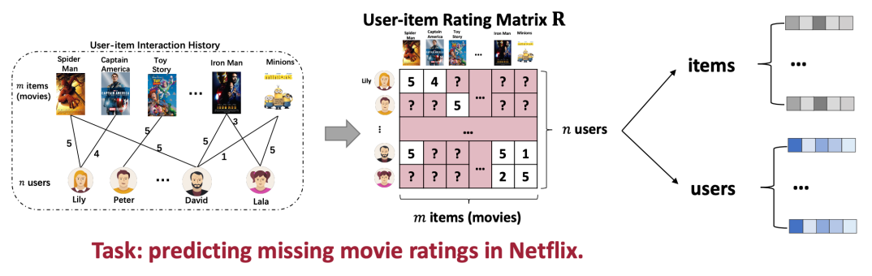
Collaborative Filtering
The most well-known set of techniques for recommendation
Similar users (with respect to their historical interactions) have similar preferences.
Modelling user’s preferences on items based on their past interactions (e.g., ratings and clicks).
Learning representations of users and items is the key
Introduction to Recommender Systems
Session 19

Slide 25

Collaborative Filtering: User-User
Nearest User
Introduction to Recommender Systems
Session 19

Slide 26
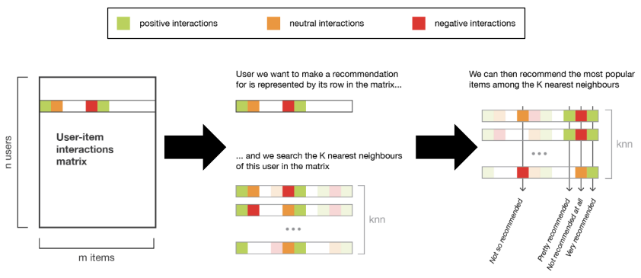
Collaborative Filtering: Nearest-User
User-User Recommendation:
Given a user u_{i}, compute their k nearest neighbors.
Recommend items that are most popular amongst the nearest neighbors.
Introduction to Recommender Systems
Session 19

Slide 27
Collaborative Filtering: User-User
Pros:
Personalized to the user
Cons:
Nearest Neighbors might be too similar
This approach only works if the nearest neighbors have interacted with items that the user hasn’t.
Feedback Loop (Echo Chambers)
Scalability
Must store and search through entire user-item matrix
Cold-Start Problem
What do you do about new users, with no data?
Introduction to Recommender Systems
Session 19

Slide 28
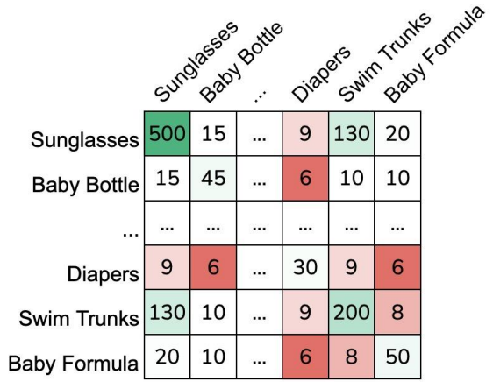
Collaborative Filtering: Item-Item
People Who Bought This Also Bougth...
Item-Item Recommendation:
Create a co-occurrence matrix of items that are bought together.
Introduction to Recommender Systems
Session 19

Slide 29
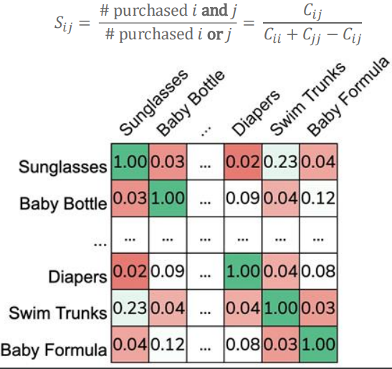
Collaborative Filtering: Item-Item
Problem: popular items drown out the rest!
Solution: Normalizing using Jaccard Similarity.
Introduction to Recommender Systems
Session 19

Slide 30
Collaborative Filtering: Item-Item
Incorporating Purchase History:
What if I know the user 𝑢 has bought a baby bottle and formula?
Idea: Take the average similarity between items they have bought
Could also weight them differently based on recency of purchase!
Then all we need to do is find the item with the highest average score!
Introduction to Recommender Systems
Session 19

Slide 31
Collaborative Filtering: Item-Item
Pros:
Personalizes to item (incorporating purchase history also personalizes to the user)
Cons:
Can still suffer from feedback loops
(As can all recommender systems – but in some cases it’s worse than others)
Scalability (must store entire item-item matrix)
Cold-Start Problem
What do you do about new items, with no data?
Introduction to Recommender Systems
Session 19

Slide 32
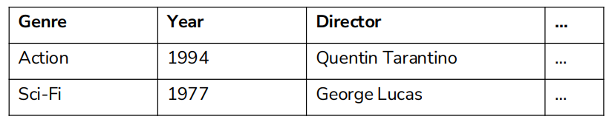
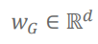
Collaborative Filtering: Feature-Based
What if we know what factors lead users to like an item?
Idea: Create a feature vector for each item. Learn a regression model!
Define weights on these features for all users (global)
Fit a linear model.
Introduction to Recommender Systems
Session 19

Slide 33
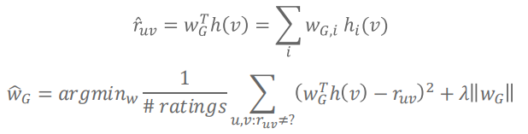
Collaborative Filtering: Feature-Based
What if we know what factors lead users to like an item?
Idea: Create a feature vector for each item. Learn a regression model!
Define weights on these features for all users (global)
Fit a linear model.
Introduction to Recommender Systems
Session 19

Slide 34
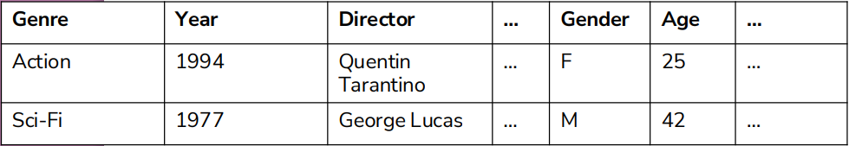
Collaborative Filtering: Feature-Based
Personalization:
Add user-specific features to the feature vector!
Introduction to Recommender Systems
Session 19

Slide 35
Collaborative Filtering: Feature-Based
Pros:
No cold-start issue!
Even if a new user/item has no purchase history, you know features about them.
Personalizes to the user and item
Scalable (only need to store weights per feature)
Can add arbitrary features (e.g., time of day)
Cons:
Hand-crafting features is very tedious and unscalable.
Introduction to Recommender Systems
Session 19

Slide 36
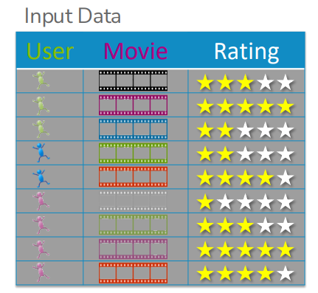
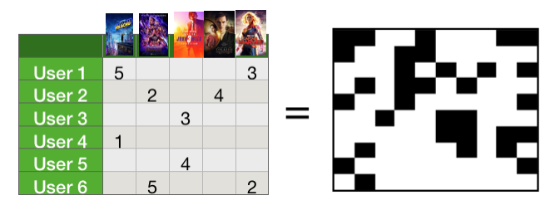
Matrix Factorization
Want to recommend movies based on user ratings for movies.
Challenge: Users have rated relatively few of the entire catalog.
Can think of this as a matrix of users and ratings with missing data!
Introduction to Recommender Systems
Session 19

Slide 37
Matrix Factorization
Assumptions:
Assume that each item has k (unknown) features.
e.g., k possible genres of movies (action, romance, sci-fi, etc.)
Then, we can describe an item v with feature vector R_{v}
How much is the movie action, romance, sci-fi, …
e.g., R_{v} = [0.3, 0.01, 1.5, …]
We can also describe each user u with a feature vector L_{u}
How much they like action, romance, sci-fi, ….
Example: L_{u} = [2.3, 0 , 0.7 , …]
Estimate rating for user u and movie v as:
Rating(u, v) = L_{u}*R_{v} = 2.3 * 0.3 + 0*0.01 + 0.7*1.5 + ...
Introduction to Recommender Systems
Session 19

Slide 38
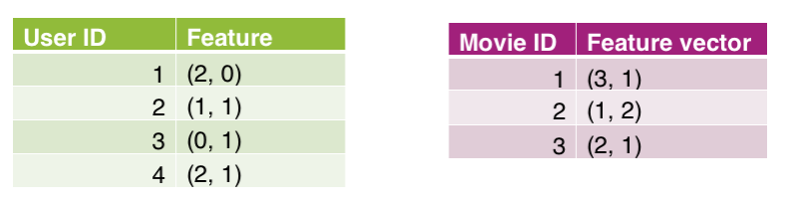
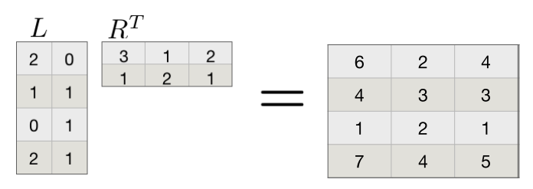
Matrix Factorization
Example:
Suppose we have learned the following user and movie features using 2 features
Then we can predict what each user would rate each movie
Introduction to Recommender Systems
Session 19

Slide 39
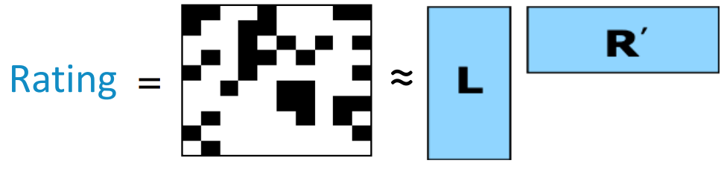
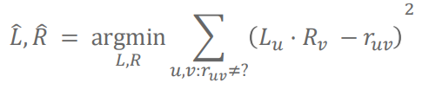
Matrix Factorization
Goal: Find L_{u} and R_{v} that when multiplied, achieve predicted ratings that are close to the values that we have data for
Our quality metric will be (could use others):
Introduction to Recommender Systems
Session 19

Slide 40
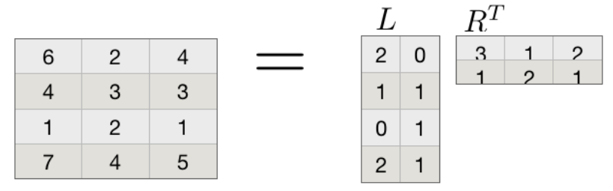
Matrix Factorization
Is this problem well posed? Unfortunately, there is not a unique solution.
For example, assume we had a solution:
Introduction to Recommender Systems
Session 19

Slide 41
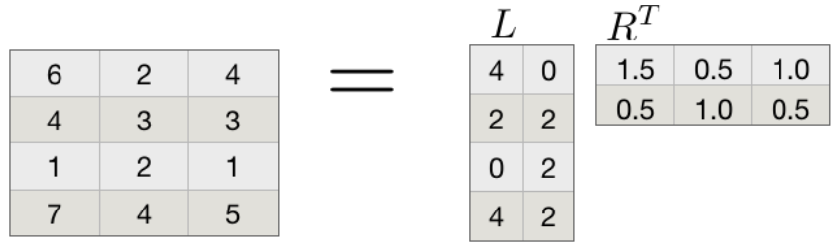
Matrix Factorization
Is this problem well posed? Unfortunately, there is not a unique solution.
Then doubling everything in L and halving everything in R is also a valid solution. The same is true for all constant multiples.
Introduction to Recommender Systems
Session 19

Slide 42
Collaborative Filtering
Pros:
Works for any kind of item
No feature selction needed
Cons:
Cold start:
Nedd enough users in the system to find a match
Sparsity:
The user/ratings matrix is sparse
Hard to find users that rated the same items
First rater:
Cannot tecommend na item that has not been previously rated
Popularity bias:
Cannot recommend items to someone with unique taste
Tends to recommend popular items
Introduction to Recommender Systems
Session 19

Slide 43
Hybrid Methods
Implement two or more different recommenders and combine predictions
Perhaps using a linear model
Add content-based methods to collaborative filtering
Item profiles for new item problem
Demographics to deal with new user problem
Introduction to Recommender Systems
Session 19

Slide 44
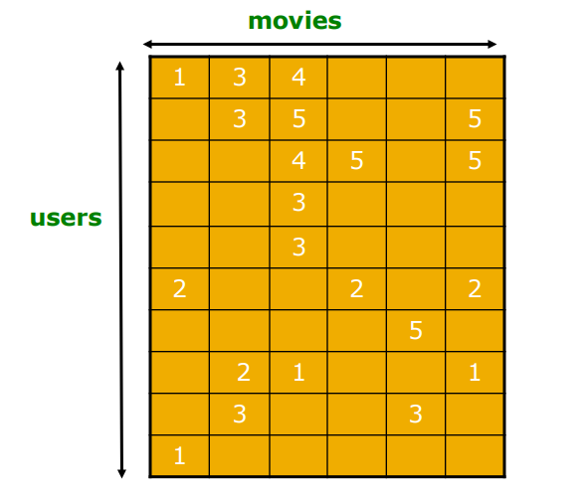
Evaluation
Introduction to Recommender Systems
Session 19

Slide 45
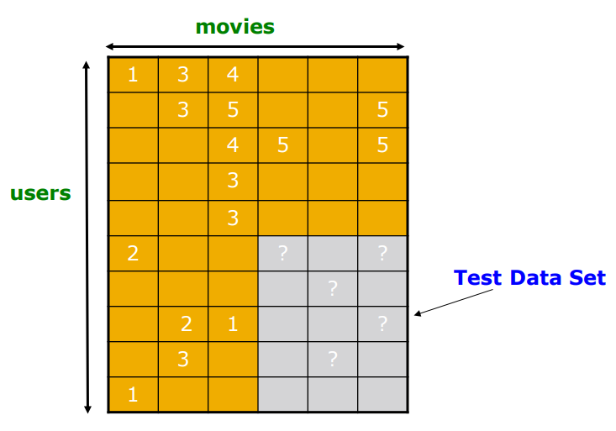
Evaluation
Introduction to Recommender Systems
Session 19

Slide 46
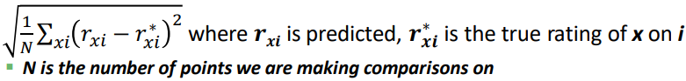
Evaluating Predictions
Compare predictions with known ratings
Root Mean Squared Error
Precision at top X:
% of relevant items in top X
Accuracy (if predicting like/dislike or click/ignore)
Another approach: 0/1 model
Coverage: number of items/users for wich the system can make predictions
Precision: Accuracy of predictions
Receiver operating characteristic: Tradeoff curve between false positives and false negatives
Introduction to Recommender Systems
Session 19

Slide 47
Problems with Error Measures
Narrow focus on accuracy sometimes misses the point
Prediction Diversity
Prediction Context
Order of predictions
In practice, we care only to predict high ratings:
RMSE might penalize a method that does well for high ratings and badly for others
Introduction to Recommender Systems
Session 19

Slide 48
Cold-Start Problem
When a new user comes in, we don’t know what items they like! When a new item comes into our system, we don’t know who likes it! This is called the cold start problem.
Addressing the cold-start problem (for new users):
Give random predictions to a new user.
Give the globally popular recommendations to a new user.
Require users to rate items before using the service.
Use a feature-based model (or a hybrid between feature-based and matrix factorization) for new users.
Introduction to Recommender Systems
Session 19

Slide 49
Top-K vs Diverse Recommendations
Top-k recommendations might be very redundant:
Someone who likes Rocky I also will likely enjoy Rocky II, Rocky III, Rocky IV, Rocky V
Diverse recommendations:
Users are multi-faceted & we want to hedge our bets
Maybe recommend: Rocky II, Always Sunny in Philadelphia, Robin Hood
Solution: Maximal Marginal Relevance
Pick recommendations one-at-a-time.
Select the item that the user is most likely to like and that is most dissimilar from existing recommendations.
Introduction to Recommender Systems
Session 19

Slide 50
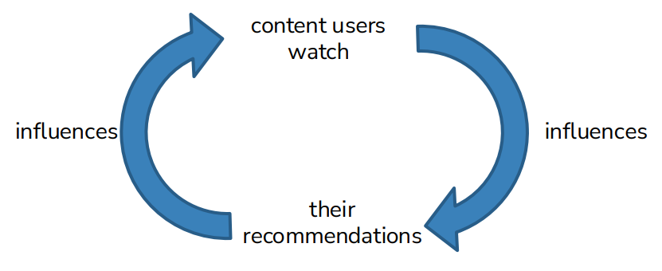
Feedback Loops / Echo Chambers
Users always get recommended similar content and are unable to discover new content they might like.
Exploration-Exploitation Dilemma
Common problem in “online learning” settings
Pure Exploration: show users random content
Users can discover new interests, but will likely be unsatisfied
Pure Exploitation: show users content they’re likely to like
Users can’t discover new interests
Find tradeoff between exploration and exploitation.
Introduction to Recommender Systems
Session 19

